Slide 1


Smart AI Airlines System
Name: Ayush Yadav (202210101150081)
Guide Name: Er. Manish Kumar Srivastava

Slide 2
Table of contents
1
Introduction
2
Objective
3
Technologies Used
4
System Workflow
6
Flight Booking Interface
7
PDF Receipt Generation System
8
Payment System
9
Advantages
5
10
AI-Based Flight Booking
Conclusion

Slide 3
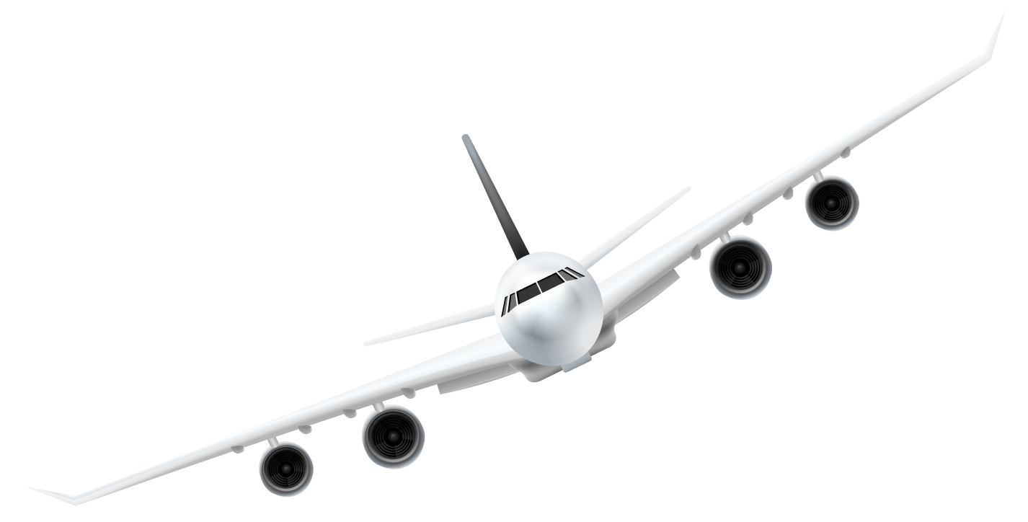
Introduction
Desktop-based airline system using Python
Allows users to book flights using AI assistance
Provides interactive and smart user experience
Uses NLP to understand user requests

Slide 4
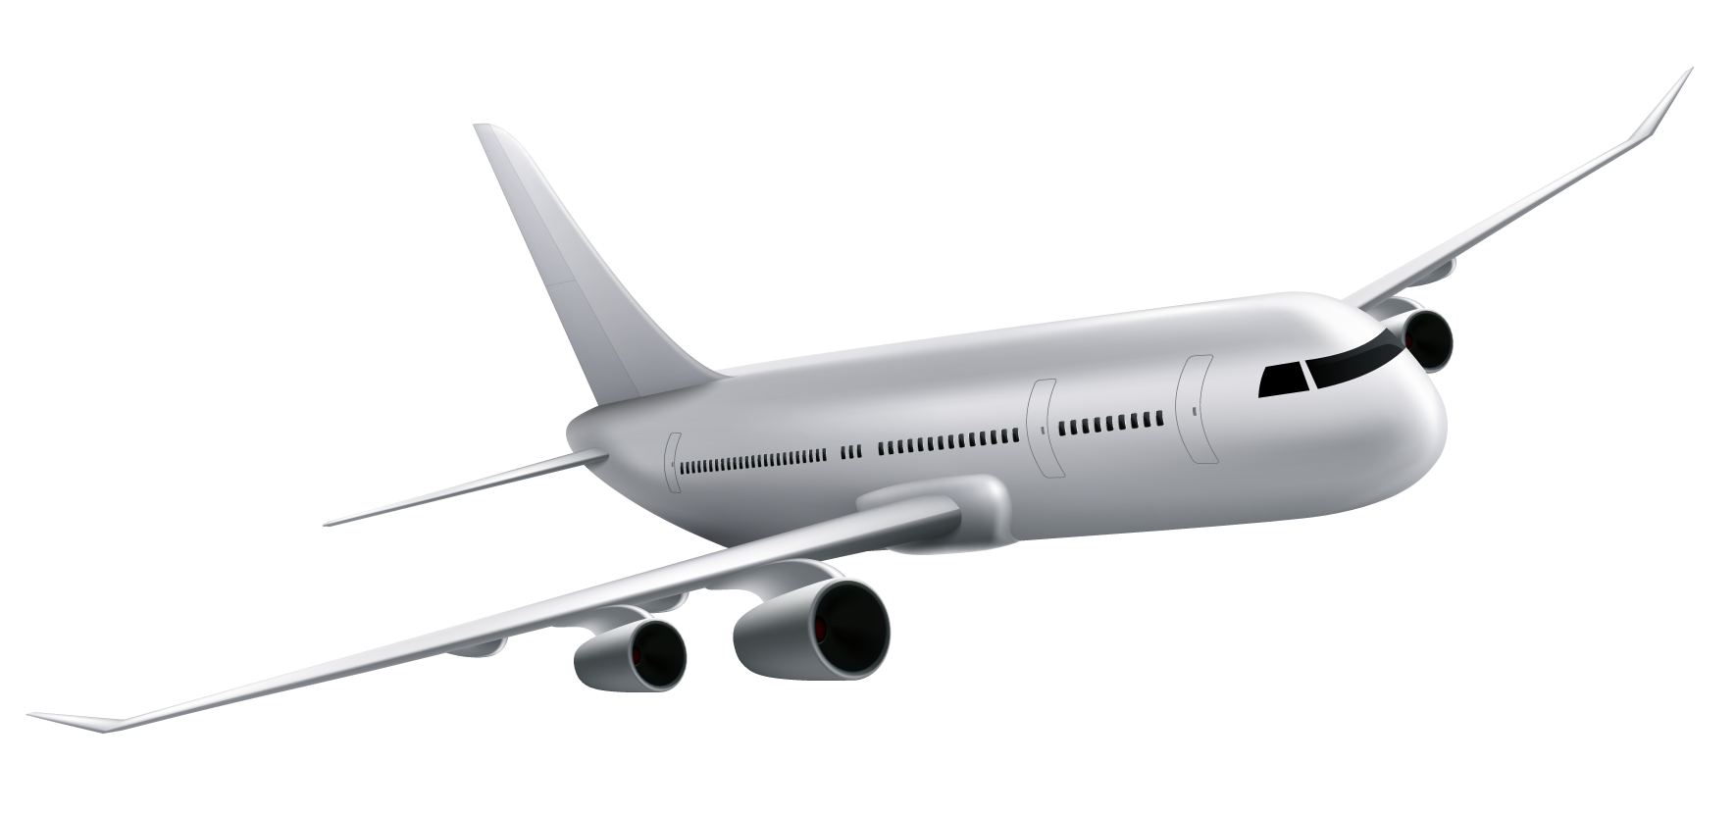
Objective
Improve overall user experience
Develop AI-based flight booking system
Reduce manual effort in searching flights
Provide quick and smart responses

Slide 5
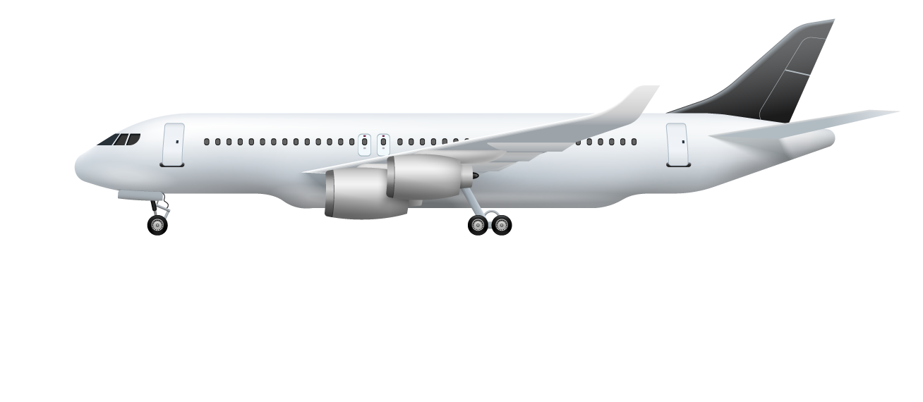
Technologies Used
Python programming language
Tkinter and ttk (for GUI development)
MySQL database
PyMySQL (for database connectivity)
Regular Expressions (re) (for basic NLP logic)
FPDF (for PDF generation)
qrcode library (for QR code generation)
Pillow (PIL) (for image processing)
GUI-based payment simulation system

Slide 6

System Workflow
1. User enters request (e.g., "Book flight to Delhi")
2. AI processes input using NLP
3. System identifies user intent
4. Matches available flights
5. Displays results and completes booking

Slide 7
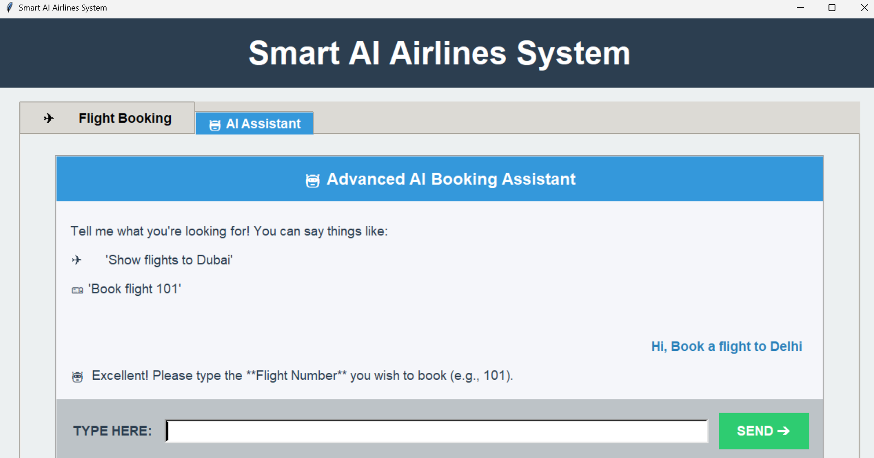
AI-Based Flight Booking
User gives command instead of manual search
AI understands destination and details
Suggests suitable flights automatically
Reduces user effort
Makes booking faster and smarter

Slide 8
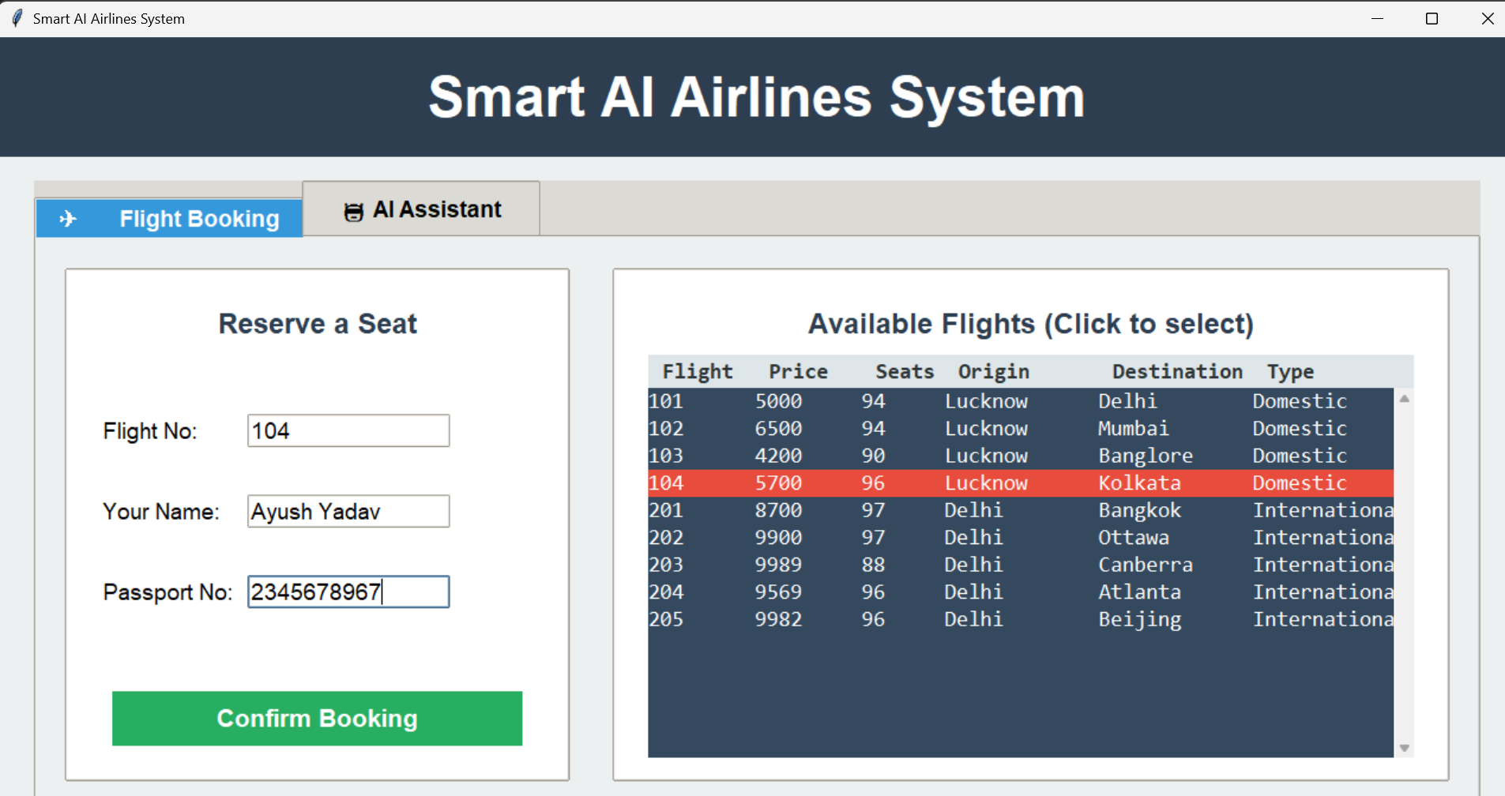
Flight Booking Interface
User can also enter details manually
Flight list is displayed
User selects and confirms booking
Easy and interactive interface

Slide 9
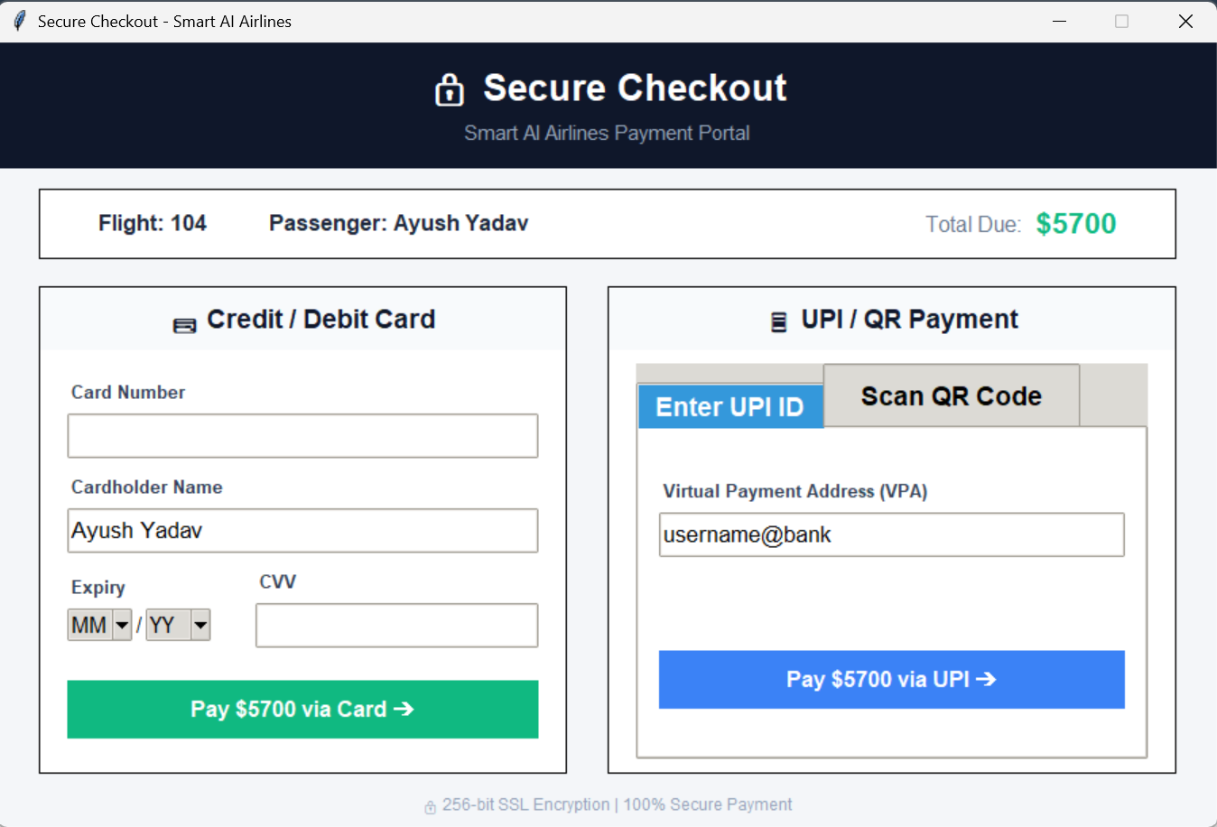
Payment System
Booking redirects to payment system
Multiple options: UPI and Card
UPI allows ID entry or QR scan
Card requires number, expiry, CVV
Payment process is simulated

Slide 10
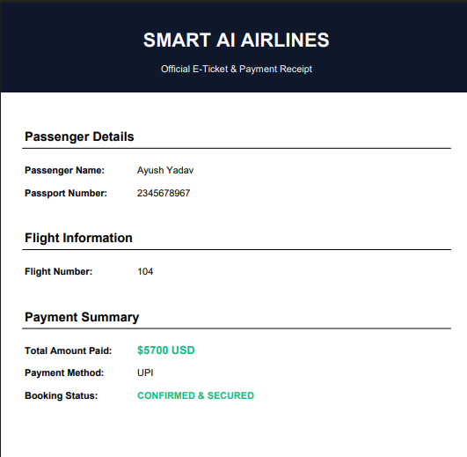
PDF Receipt Generation System
Generates E-ticket & receipt automatically
Built using FPDF in Python
Includes passenger, flight & payment details
Shows booking status (confirmed)
Allows download/save as PDF

Slide 11
Advantages
1. AI-based booking system
2. Saves time and effort
3. User-friendly interface
4. Smart and automated

Slide 12
Conclusion
Smart AI system for flight booking
Reduces manual work
Improves efficiency and user experience
Can be enhanced for real-world use

Slide 13
Literature Review
Early airline systems were manual and less efficient
Web systems enabled online booking (Hossain et al.)
Databases manage flight & booking data (Elmasri & Navathe)
GUI improves user experience
AI chatbots automate support (Stuart Russell & Peter Norvig)
NLP enables natural language queries (Daniel Jurafsky & James H. Martin)
Payment & e-ticketing improve efficiency
Gap: No fully integrated smart system
Proposed: All features combined in one system

Slide 14
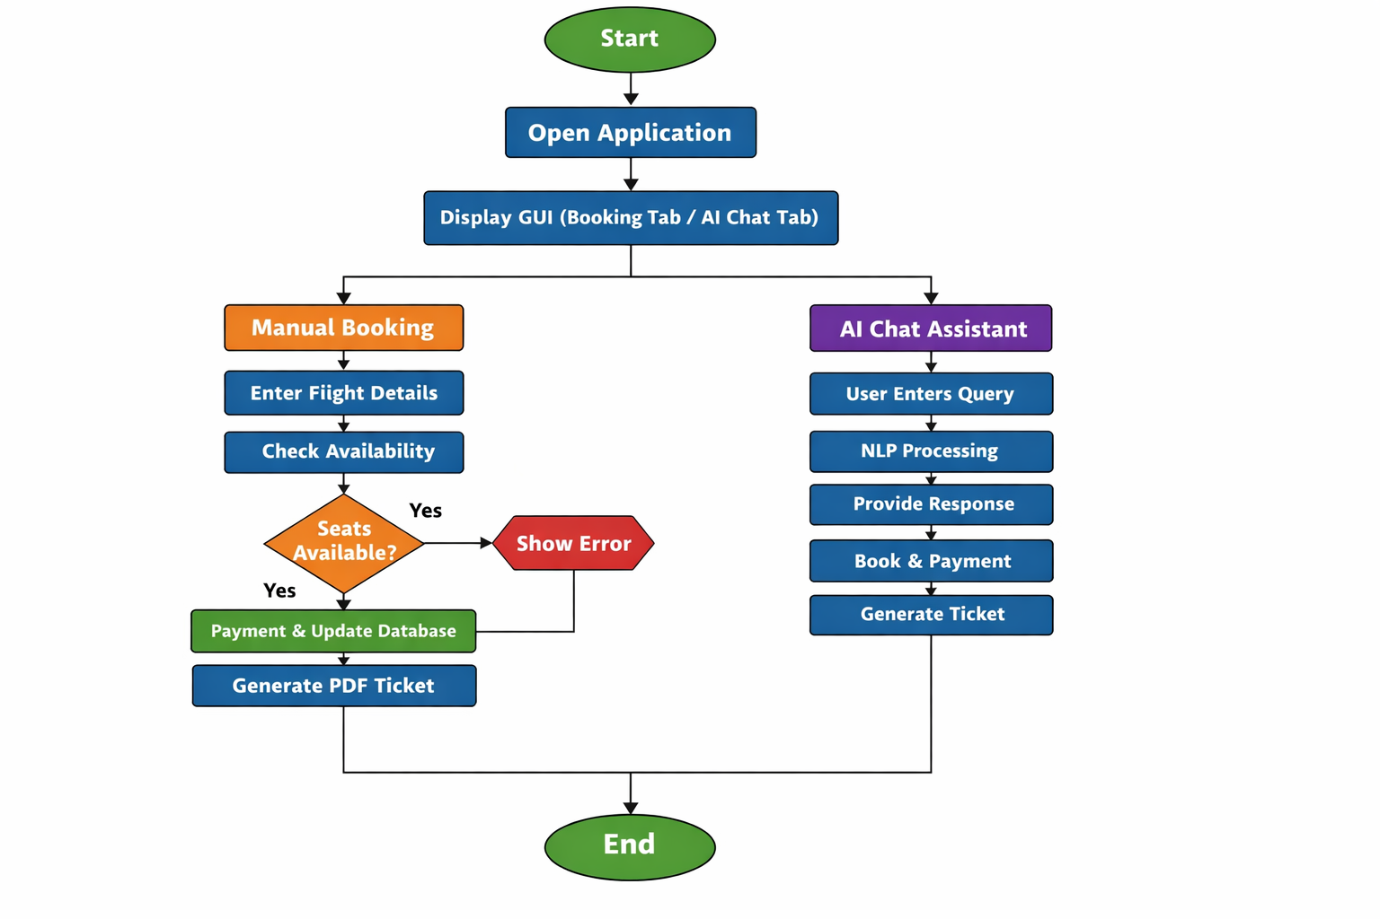
Flowchart

Slide 15
References
Pressman, R. S. – Software Engineering: A Practitioner’s Approach
Kurose, J. F. & Ross, K. W. – Computer Networking: A Top-Down Approach
Elmasri, R. & Navathe, S. – Fundamentals of Database Systems
Russell, S. & Norvig, P. – Artificial Intelligence: A Modern Approach
Jurafsky, D. & Martin, J. – Speech and Language Processing (NLP)
Python Official Documentation – https://docs.python.org
MySQL Documentation – https://dev.mysql.com/doc/
Tkinter Documentation – https://docs.python.org/3/library/tkinter.html
FPDF Documentation – https://pyfpdf.readthedocs.io/
qrcode Library Docs – https://pypi.org/project/qrcode/

Slide 16
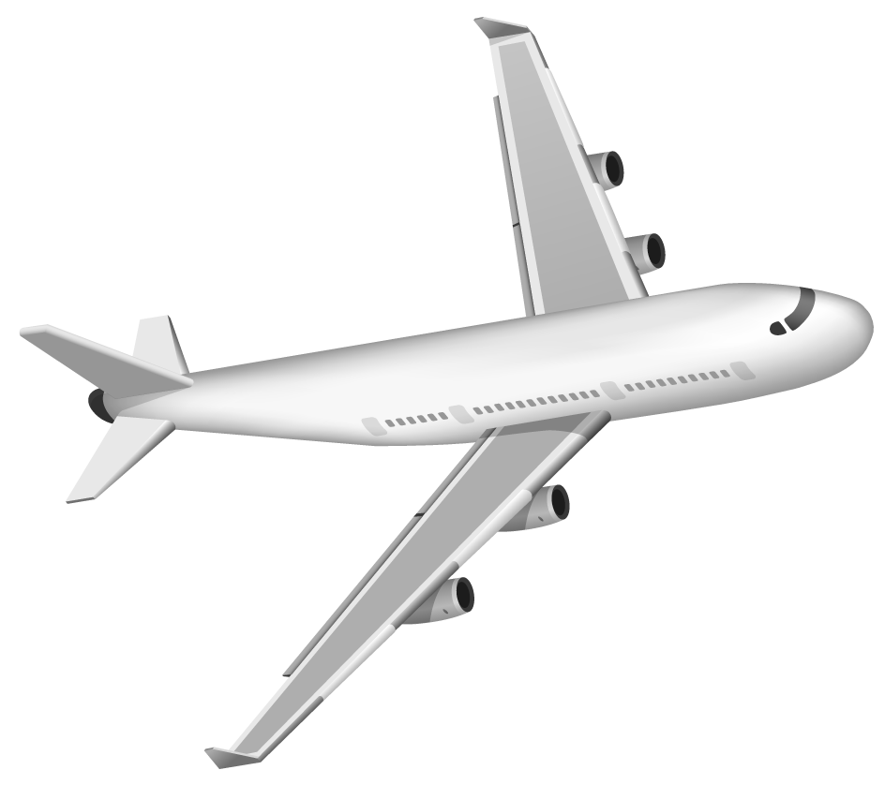
Thanks!

